Slide 1
Corrosion
Corrosion is when metals react with substances in the Air to produce compounds.
The metal is changing from an atom to an ion.
The metal atom looses electrons when it corrodes – it is oxidised.

Slide 2
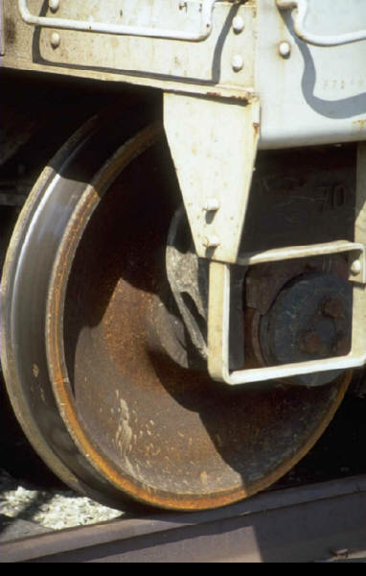
Rusting
This is the name given to the corrosion of iron.
When most metals corrode their surface is damaged.
Iron corrodes when it is in the presence of Water and Oxygen.
It’s surface becomes flaky and red – damaged.

Slide 3
The Reactivity Series
Metals at the top of the reactivity series will corrode more quickly than metals lower down.
Metals are used according to their properties.
Example
Gold, Silver – jewellery – corrosion resistant.
We would not use iron since it rusts ( corrodes) easily.

Slide 4
Detecting Rusting
When iron rusts it does so in 2 stages.
First rust
Fe(s) --------> Fe ²⁺ (aq) + 2e
Second rust
Fe ²⁺ (aq) --------> Fe ³⁺ ( aq) + e
We can detect the presence of Fe ²⁺ ions using Ferroxyl Indicator – it turns BLUE

Slide 5
Rate of Corrosion
This is increased when dissolved substances are present – i.e. acids and electrolytes.
OR
If the metal is connected to a metal lower in the electrochemical series – the metal will loose electrons – the lower metal will gain them.
Or - connect to + terminal in a battery

Slide 6
Rust Indicator
Ferroxyl Indicator
Fe ²⁺ ions
The Ferroxyl indicator turns blue when Fe²⁺ ions are present – we can show the iron is being oxidised. Fe(s) —> Fe ²⁺(aq) + 2e
OH- ions
When Iron looses electrons they are picked up by water which is reduced(p7 data book)
2H₂O(l) + O₂(g) + 4e —> 4OH⁻(aq)
Ferroxyl indicator turns PINK is the presence of OH⁻ ions.

Slide 7
Preventing Corrosion
We can do this in 2 ways : Chemically and Physically
Physical Protection
Provide a barrier against the Oxygen and Water – paint, grease , oil, coat with plastic, coat with Zinc( galvanise)

Slide 8
Chemical Protection
Cathodic Protection
Connect the metal/Iron to the negative terminal of a battery – constant supply of electrons – e.g. car bodies connected to – terminal of car battery.
Sacrificial Protection
Connect the Iron to a metal higher in the electrochemical series – the higher metal donates electron to the Iron – e.g. Mg strips on the hull of a ship.

Slide 9
.
Galvanising
Coating with Zinc – physical barrier – when scratched acts as sacrificial protector ( Zn higher than Fe in Electrochemical Series)
Tin Plating
Physical barrier only – when surface is scratched Fe protects the Sn

Slide 10
Electroplating
Connect the metal to be plated at the negative electrode. e.g Iron
Place the metal you want to plate it with at the positive terminal e.g. Nickel.
The metals must be in a solution of the plating metal ions i.e.Nickel.
When you switch on the current -The Nickel ions in the solution will move to the negative electrode where they will receive electrons and form atoms. Solid Nickel will form on top of the Copper.
Ni ²⁺(aq) + 2e —> Ni(s)

Slide 11
Anodising
When Al is oxidised a layer of Al₂O₃ forms on the surface and protects the metal atoms below from oxidation.
Anodised Aluminium is strong and is used in window frames.

